Slide 1
Transmission Media
Covers Chapter# 07 from Text Book
Computer Communication & Networks
(CEN-223)
Fall 2022 (BSE-5A)

Slide 2
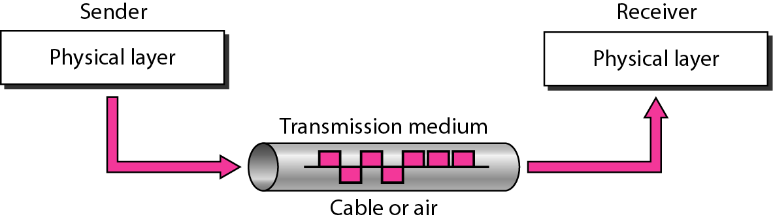
Transmission Medium
Transmission Medium: broadly defined as anything that can carry information from a source to a destination.
Computers and telecommunication devices use signals to represent data.
Signals are transmitted in form of electromagnetic energy that propagates through transmission medium.
Sender
Receiver

Slide 3
Classes of Transmission Media
Transmission Media
Guided (wired)
Unguided (wireless)
Twisted-pair cable
Coaxial cable
Fiber-optic cable
Radio wave
Microwave
Infrared
Examples

Slide 4
Guided Media

Slide 5
Guided Media (Wired)
Guided media: those media that provide a conduit from one device to another, including:
Twisted-pair cable
Coaxial cable
Fiber-optic cable
Properties; signals are directed and contained by the physical limit of the medium.
Transport signals in form of electric current
Transport signals in form of light

Slide 6
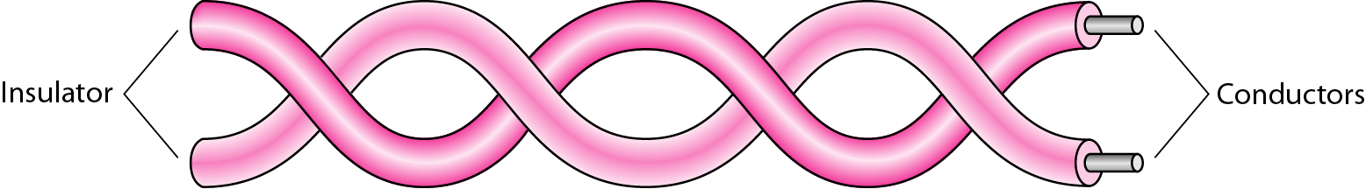
Twisted-Pair Cable
Twisting the cables helps in reducing unwanted signals at the receiver side, i.e. noise or crosstalk.
Types of twisted-pair cables:
Shielded twisted-pair (STP): A metal foil encases each pair of insulated conductors, which further reduces noise or crosstalk, but at expense of being bulkier and more costly.
Unshielded twisted-pair (UTP): Unshielded Twisted Pair (UTP) is a type of cable that consists of pairs of insulated copper wires twisted together.

Slide 7
Shielded twisted pair cable (STP) has the individual pairs of wires wrapped in foil, which are then wrapped again for double protection.
Unshielded twisted pair cable (UTP) has each pair of wires twisted together. Those wires are then wrapped in tubing without any other protection.

Slide 8
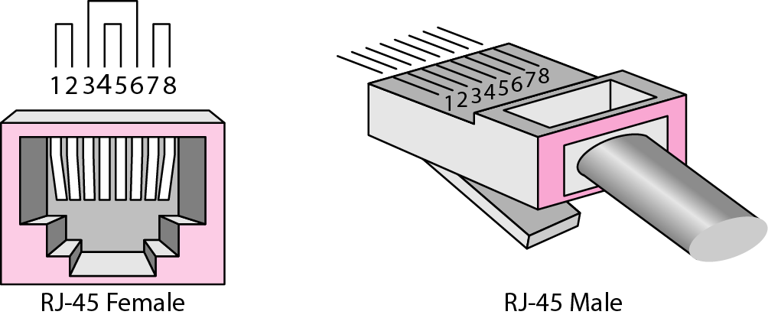
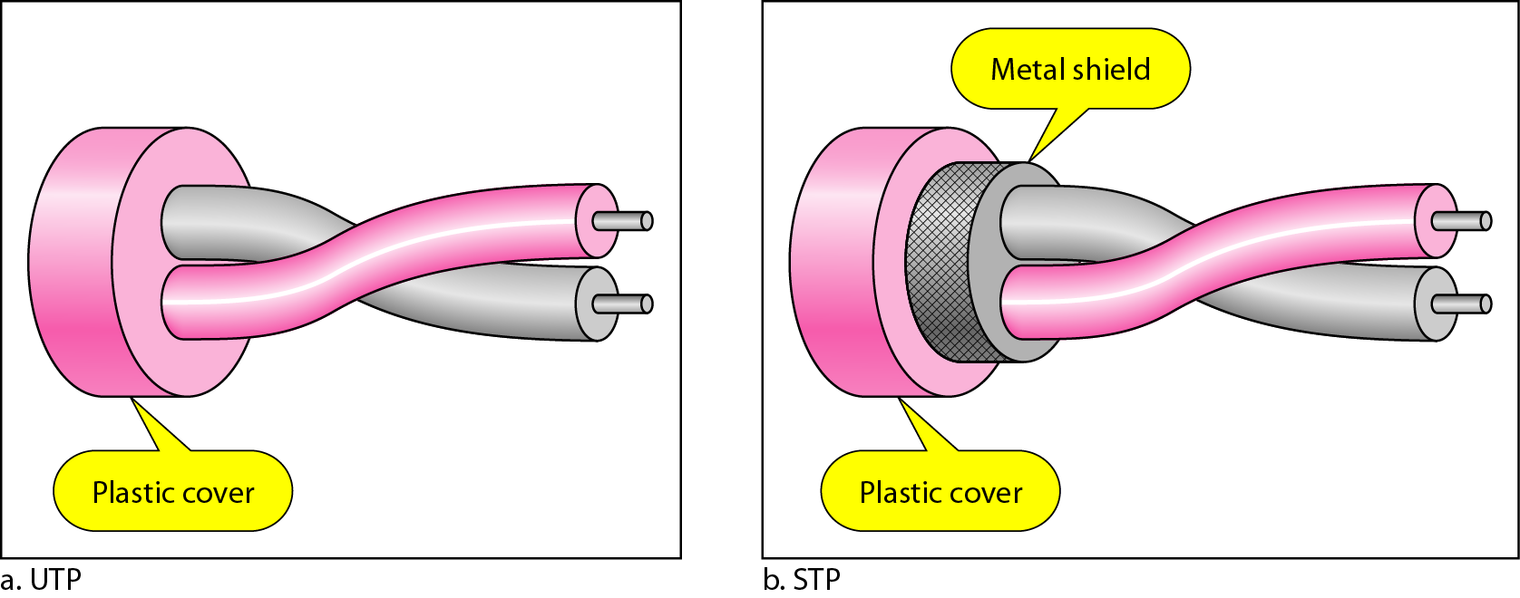
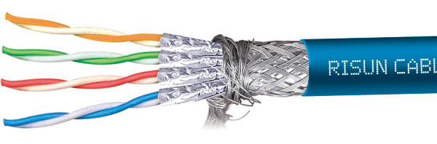
Twisted-Pair Cable (Cont.)
UTP and STP
cables
TP connector
Category 7 Twisted-Pair Cable

Slide 9
Twisted-Pair Cable (Cont.)
Applications:
Telephone lines
The local loop: i.e., the line that connects subscribes to the central telephone office.
Digital subscriber line (DSL)
Local area networks (LANs)

Slide 10
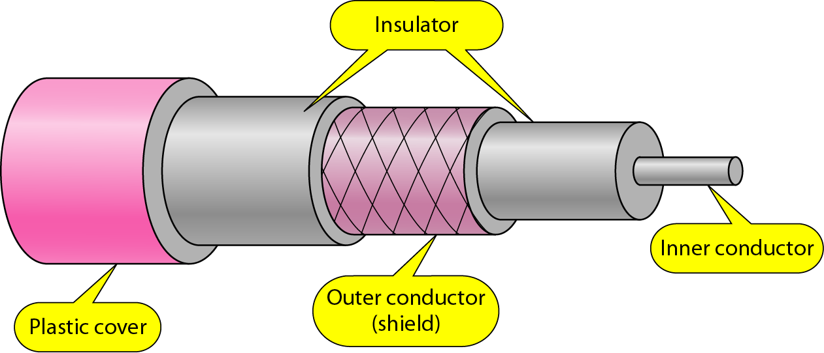
Coaxial Cable
Can carry signal of higher frequency than twisted-pair cable.
Cable composition:
Central core conductor of solid wire (copper).
The first insulating sheath.
Outer conductor of metal foil (serves as a shield against noise and as a second conductor)
The second insulating sheath.
Plastic cover.
Applications: Cable TV networks.

Slide 11
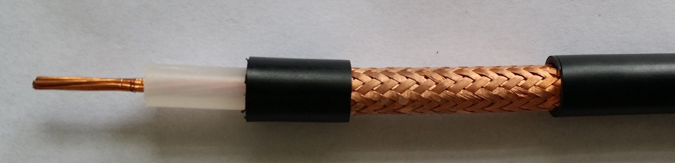
Coaxial Cable (Cont.)
https://www.linkedin.com/pulse/structure-characteristics-coaxial-cable-fob-electronic

Slide 12
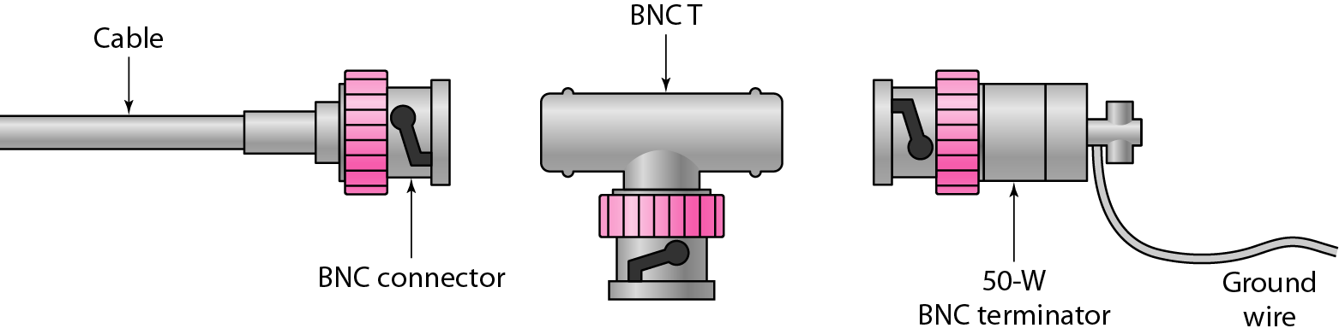
Coaxial Cable (Cont.)
BNC connector as most common coaxial connectors.
BNC connector: connects the end of cable to a device, such as a TV.
BNC (T) connector: used for branching out a connection to a computer or other device.
BNC terminator: used at end of the cable to prevent reflection of signals.

Slide 13
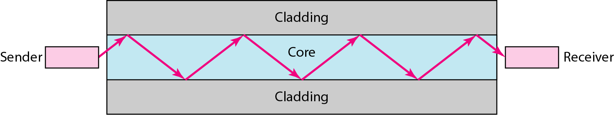
Fiber-Optic Cable
Fiber-optics properties:
Made of glass or plastic.
Transmits signal in form of light.
Uses reflection property to guide light through a channel.
Fiber-optic core; glass or plastic.
Fiber-optic cladding; glass or plastic of less density than core.
Optical fiber structural diagram

Slide 14
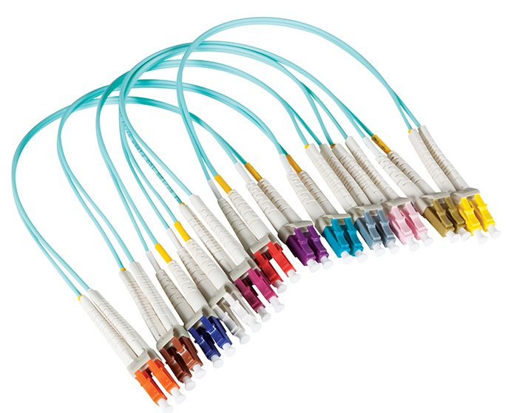
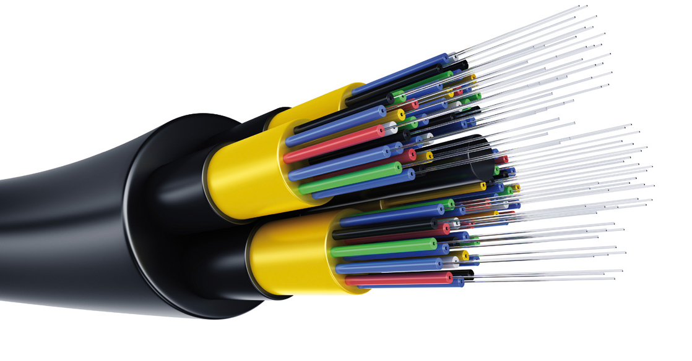
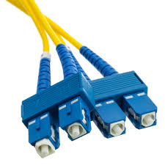
Fiber-Optic Cable (Cont.)

Slide 15
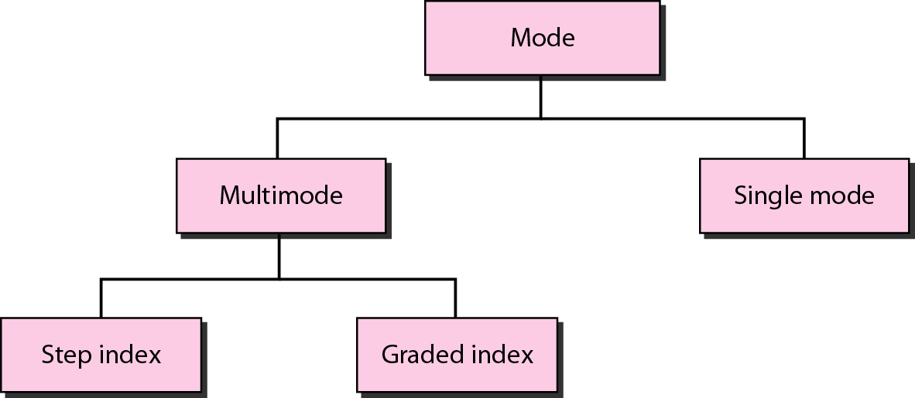
Propagation Modes in Fiber-Optics
Propagation modes in fiber optic cable

Slide 16
Propagation Modes in Fiber-Optics (Cont.)
Multimode: multiple beams from a light source can move through the core in different paths.
Step index:
Sudden change in light beam movement.
Causes attenuation and distortion of signal.
Graded index:
Smooth change in light beam movement.
Decreases attenuation and distortion.
Single-mode: propagation of beam is almost horizontal.
Can transmit 100 Gbps for 100 km without amplifier. Why?

Slide 17
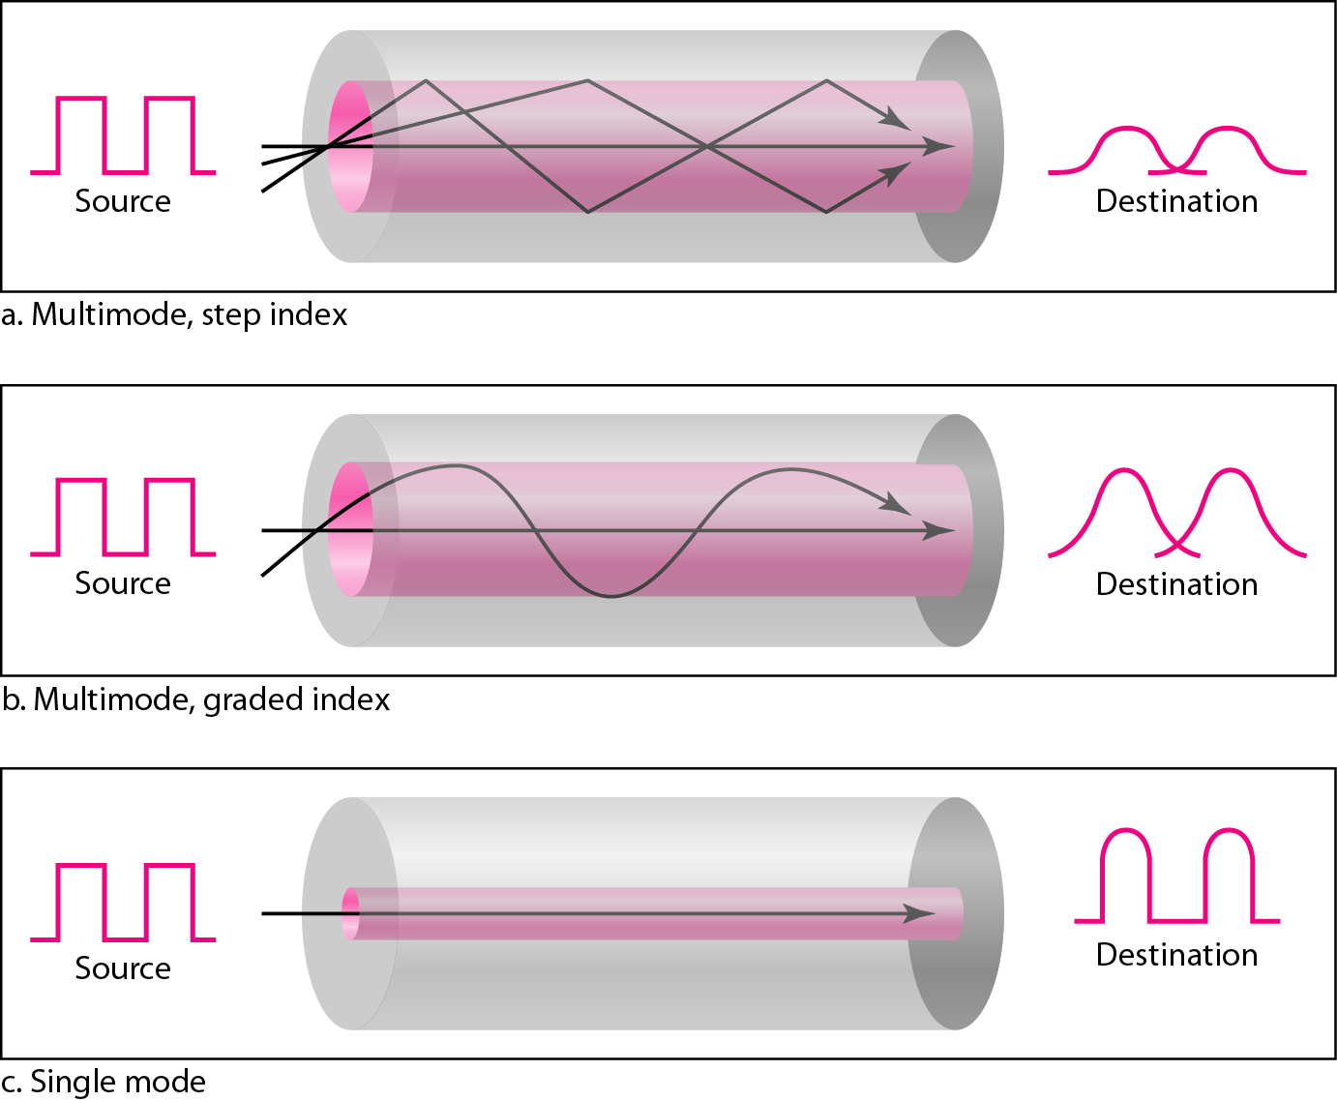
Fiber-Optic Cable (Cont.)
Illustrative diagrams for the propagation modes in fiber-optics cables.

Slide 18
Fiber-Optic Cable (Cont.)
Applications: Backbone networks, Cable TV, Fiber to the Home (FTTH), Fast Ethernet.
Advantages: Light weight, Higher bandwidth, Less signal attenuation, Resistance to corrosive materials, Immunity to EM interferences, Greater immunity to tapping.
Disadvantages: Requires installation and maintenance expertise (which is relatively scares), Costly setup.

Slide 19
Unguided Media

Slide 20
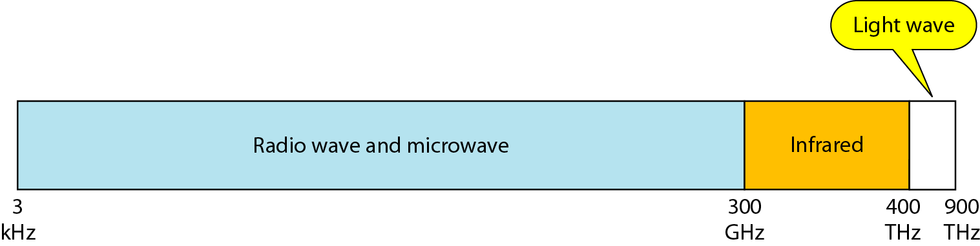
Unguided Media (Wireless)
Unguided media: those media that transport electromagnetic waves without using a physical conductor.
Usually broadcasted in the medium (air, vacuum and water).
Part of EM spectrum is used for wireless communication.
Electromagnetic spectrum for wireless communication

Slide 21
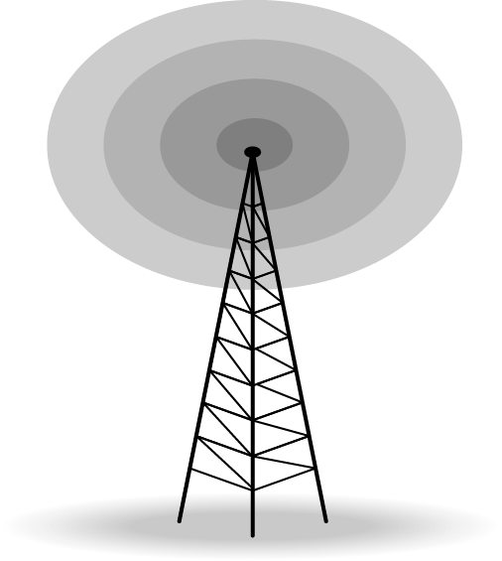
Radio Waves
Properties:
There is no clear-cut demarcation between radio and microwaves.
EM waves ranging between 3 kHz and 3 GHz.
Mostly uses omnidirectional antennas (i.e. waves propagate in all directions).
Radio waves can penetrate walls, particularly those of low and medium frequencies.
Almost entire band is regulated, hence requires permission from authorities before usage.

Slide 22
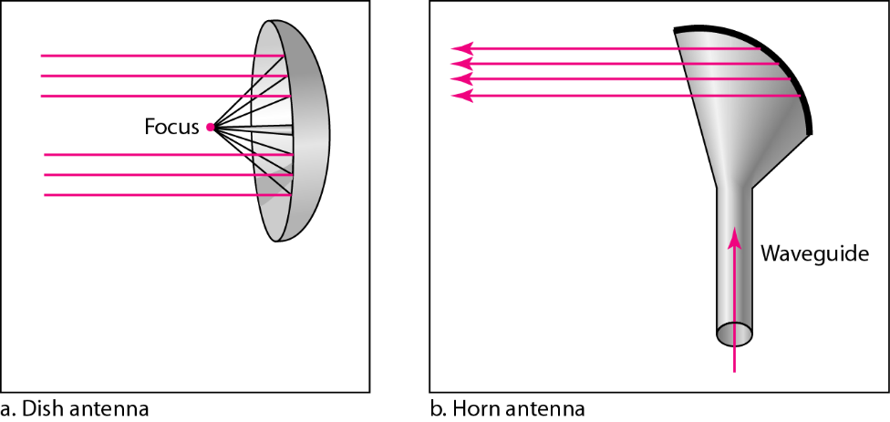
Microwaves
Properties:
EM waves ranging between 3 GHz and 300 GHz.
Sending/receiving antennas need to be aligned, i.e. line-of-sight.
High frequency microware cannot penetrate walls.
Used in satellite networks and communication among cellular base stations.
Usage requires permission from authorities.

Slide 23
Infrared
EM waves ranging between 300 GHz and 400 THz.
Used for short range communication.
Cannot penetrate walls, and requires line-of-sight. Hence, avoids interference with devices in other rooms.
Useless for long-range communication.
Cannot be used outside, since sun’s rays contain infrared waves.
The Infrared Data Association (IrDA) established standards for communication between devices, such as keyboards, PCs, printers.

Slide 24
Thank You!

